Slide 1


Setting Up a GitHub Repository
Dylan Bellinger
Information Technology

Slide 2

Reflection
I chose this topic because I think GitHub is a useful and relevant tool that closely relates to the studies of our class. When I started using it in my senior year of class, it had caught my attention as something that could be put to good use for collaborating on projects. Since repositories are an important part of GitHub, I chose to focus on how to create one with an account.

Slide 3


Research Methods
One method I used to gather information was visiting the GitHub website itself where it had instructions on creating a repository.
Another method I used was searching up YouTube videos on the subject that contained information about repositories.
This Photo by Unknown author is licensed under CC BY-SA.

Slide 4
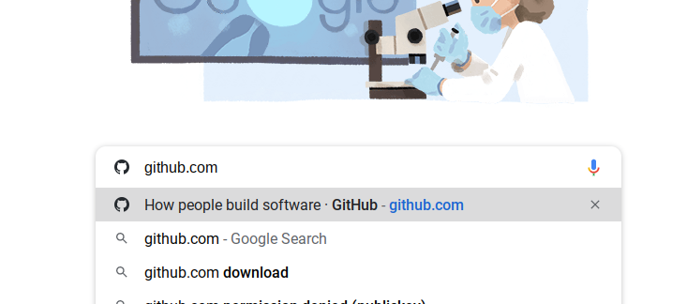
Step One
Enter GitHub.com into the search bar of your web browser to arrive at the GitHub website.

Slide 5
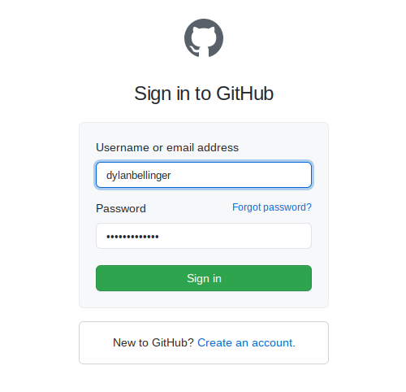
Step Two
Sign into GitHub using either your username or email address and password or create a GitHub account using your email address.

Slide 6

Step Three
Once you are logged in, click the dropdown menu next to the plus (+) sign in the upper right corner of the webpage and click "New Repository."

Slide 7
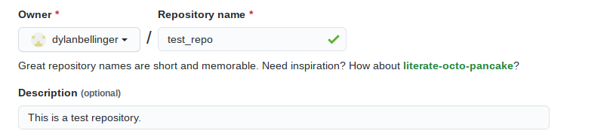
Step Four
Enter in a name for your repository, as well as a description if you so choose.

Slide 8

Step Five
Select a visibility setting for your repository. You can select "Public" in which anyone can see the contents of your repository, "Internal" in which only members of your organization may see the contents (if an organiztion is connected), and "Private" in which you choose who gets to see the contents.

Slide 9

Step Six
Check the box that reads "Initialize this repository with a README." This allows you to add a file containing instructions about the repository created for other people who might use it.

Slide 10

Step Seven
Click on the button that reads "Create repository." After you complete this step, your Git repository will be created and ready to use.

Slide 11

Questions
What would a repository be used for?
In GitHub, you would use a repository for storing project files that you can collaborate with others to work on.
What types of files can be stored in a repository?
Typically, you would store files that relate to coding projects, such as HTML, CSS and JavaScript files.
How much does GitHub cost to use?
As of April of 2020, GitHub is free to use for teams.
This Photo by Unknown author is licensed under CC BY.

Slide 12

Post Reflection
One new skill I have better mastered because of this project is managing accessibility in a repository, as it is important for letting the right people see and manage the contents. Another skill I have improved is initialization, since I had learned that repositories with a REAME file could be used to help with instructions for other users.
This Photo by Unknown author is licensed under CC BY.

